Slide 1
Using blockchain in the education sector for trusted credentials.
By
Satya tejeswar adapa
12177830

Slide 2
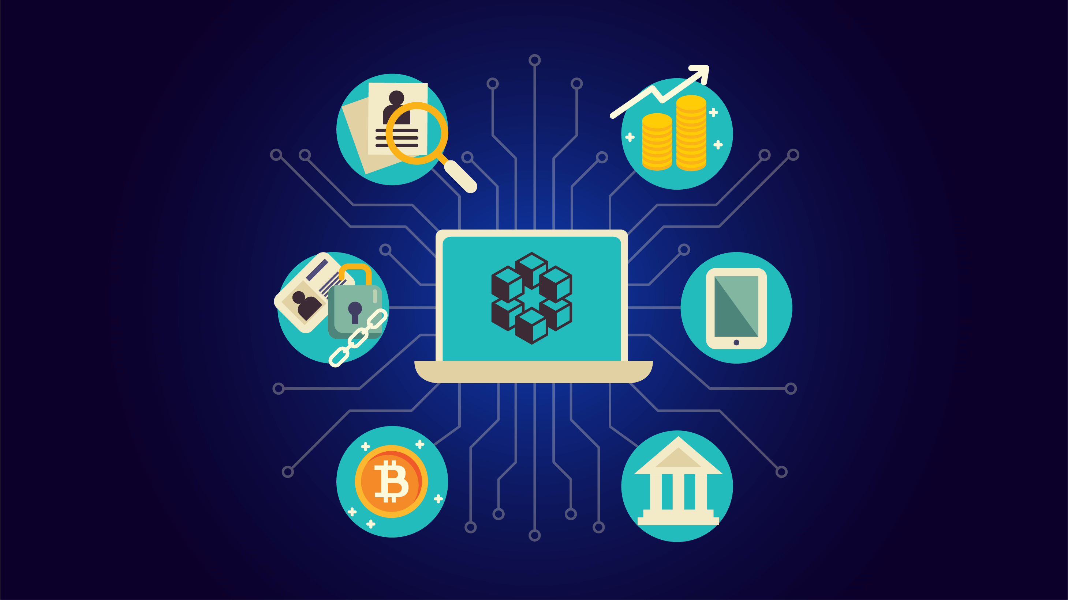
Blockchain is a secure decentralized ledger, used in many fields including healthcare, education, and banking.
Recently, blockchain technology has gained considerable attention from researchers and practitioners. There are three main themes: educational applications developed with blockchain technology, benefits that blockchain technology could bring to education, and challenges with adopting blockchain technology in education.

Slide 3
Introduction
Blockchain technology was introduced in 2008 to eliminate third parties and allow users to make their transactions directly and is currently used to register the transactions of Bitcoin cryptocurrency.
The blockchain is a distributed ledger. It holds records, such as accounting records, but also offers other services like smart contracts and a built-in rewards system.

Slide 4
What Could Blockchains Do for Education?
There are many applications and benefits of blockchain-based ledger technologies for education:
1. Student records.
Academic transcripts are one of the most time-consuming task in academic institutions today. Before issuing a certified transcript of a student’s grades, each entry must be manually verified to ensure perfection.
In K-12 education, a student might take one course, but move to another state where the teacher teaches another course with the same name. If this information was stored on a blockchain, then a student can compare the courses' content.

Slide 5
2. Diplomas and certificates.
Just like grades, a student’s diplomas and credentials could be issued and stored on a blockchain.
In 2017, MIT began issuing digital diplomas to its graduates, which would prevent people from submitting fake degrees to potential employers.
3. Badges.
A resume doesn't tell employers about skills such as foreign language skills or the ability to set up a computer network, but a third-party can verify these skills and grant a certificate or badge.
4. File storage.
If an institution wants to store digital curricula on local hard drives, that could be a problem. A possible solution could be blockchain-based cloud storage services.

Slide 6
5. Lessons and courses.
Most blockchains are also capable of executing smart contracts and allowing teachers to automatically verify the completion of tasks in exchange for crypto tokens.
6. Publishing.
Undergrad and grad students, teachers, professors, and researchers generate quality material, but the road to publication is hard. But publishing on a blockchain could help new writers, researchers and many others break into the industry.
7. Lower costs.
Many time-consuming, labor-intensive processes could be automated. This would reduce costs for students and reduce the amount of time they spend paying back loans.

Slide 7
The End
https://drive.google.com/file/d/1mTHX2V1mc13f7CvSvvsSWFRA4IcZykpi/view?usp=drivesdk

